Slide 1
Learning to Track: Online Multi-object Tracking by Decision Making
Yu Xiang, Alexandre Alahi and Silvio Savarese
ICCV 2015

Slide 2
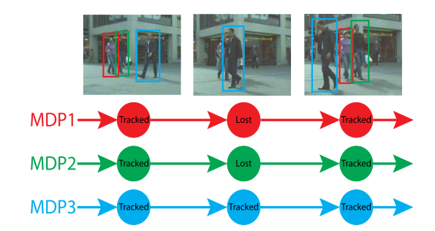
Introduction
Online Multi Object Tracking
Detector and tracker working in parallel
Target lifetime modeled as a Markov Decision Process (MDP)
Reinforcement Learning used to learn similarity function for data association

Slide 3
Markov Decision Process
Four states – active, tracked, lost, inactive
Seven actions
Deterministic Transition Function
Notes:
When an object is first detected, it is active; true detection becomes tracked and false ones become inactive;
Tracked targets remain tracked as long as it is tracked successfully and transition to lost if the object gets occluded or goes out of view;
Lost objects become inactive if they remain lost for a threshold number of frames and go back to tracked if associated successfully with a detection;
Once inactive, the object is discarded forever and there is no going back;

Slide 4
Active State Policy
Initial state when an object is first detected
Transition to tracked (a₁) or inactive (a₂)
Train binary SVM using a 5D feature vector:
x, y coordinates, width, height, detection score
Equivalent to learning reward function:
Notes:
As mentioned before, when an object is first detected, it is active; true detection becomes tracked and false ones become inactive;
In order to distinguish between true and false detections, a binary SVM classifier is trained using examples from the training sequences;
A 5D feature vector is used consisting of the coordinates of the center, width, height of the bounding box and a confidence score provided by the detector;
Non maximum suppression and thresholding on detection scores are first used as preprocessing steps to remove detections covered by tracked targets;

Slide 5
Tracked State Policy
An existing object that is visible in the current frame
Remain tracked (a₃) or transition to lost (a₄)
Decision depends on the tracking method used
TLD used here
Notes:
The framework is general so can employ any tracking method; the decision to classify an existing object

Slide 6
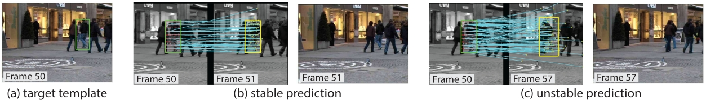
Tracked State Policy – Tracking
Template represented by image patch under the bounding box
Optical flow of densely uniformly sampled points in template
Iterative Lucas Kanade with Pyramids
Forward - Backward (FB) estimation used to estimate stability
Patches from all tracked frames are collected
Used as target history for data association
Lazy update
Template updated only when target gets lost
Notes:
The framework is general so can employ any tracking method; the decision to classify an existing object;
A set of patches/templates are stored – one from each tracked frame – though the latest one may not be the one being used as the template for optical flow;
This delayed update is done to reduce tracker drift that inevitably follows when updating the template too frequently;

Slide 7

Tracked State Policy – Decision Making
2D feature vector used for decision making
Median FB Error
Euclidean distance between initial point and FB prediction
Mean bounding box overlap between the target history and corresponding detections
Optical flow can continue tracking false detections
False objects cannot be detected consistently
Equivalent reward function:
Notes:
The framework is general so can employ any tracking method; the decision to classify an existing object

Slide 8

Lost State Policy
Target is occluded or goes out of view of the camera
Remain lost (a₅) or transition to tracked (a₆) or inactive (a₇)
Inactive if lost for more than $T_{Lost}$ frames
Data association used for deciding between lost and tracked

Slide 9
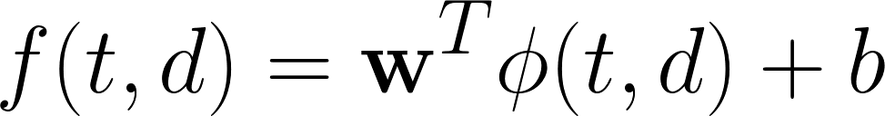

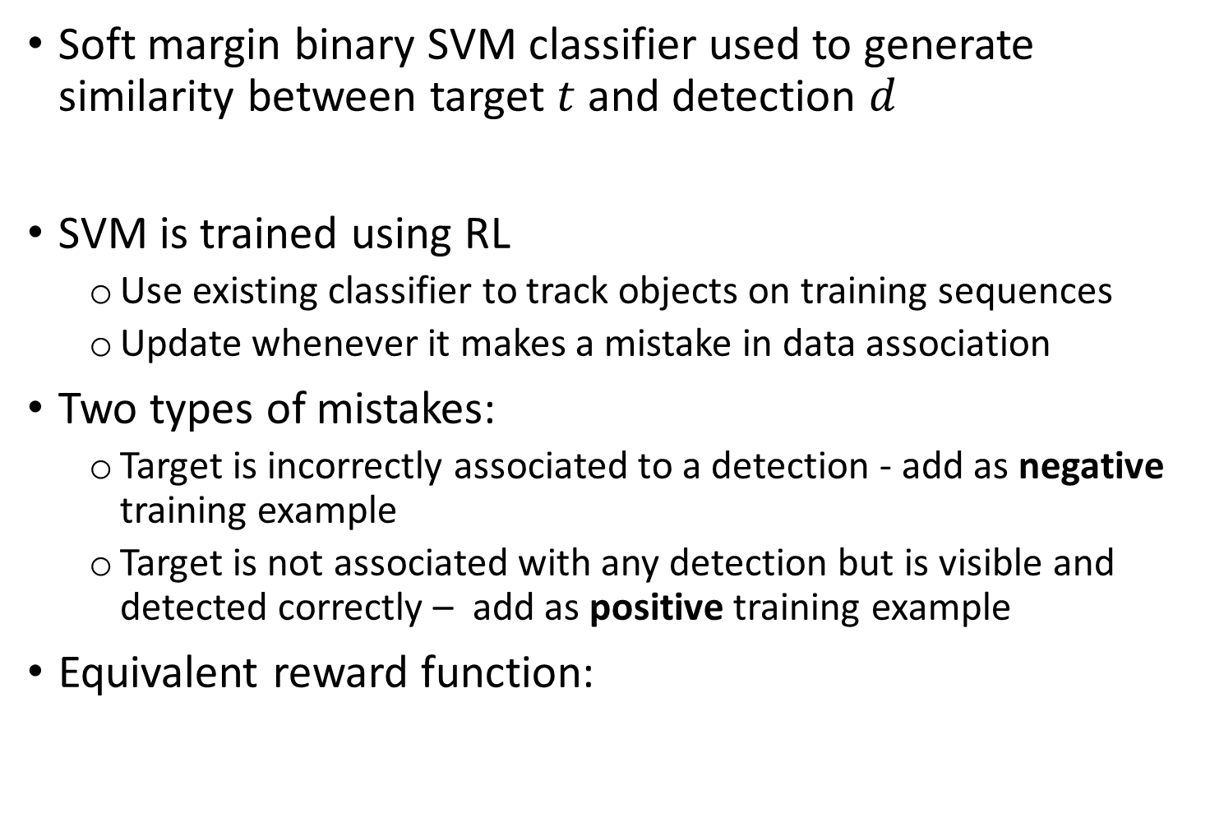
Lost State Policy – Data Association
Soft margin binary SVM classifier used to generate similarity between target $t$ and detection $d$
SVM is trained using RL
Use existing classifier to track objects on training sequences
Update whenever it makes a mistake in data association
Two types of mistakes:
Target is incorrectly associated to a detection - add as negative training example
Target is not associated with any detection but is visible and detected correctly – add as positive training example
Equivalent reward function:

Slide 10
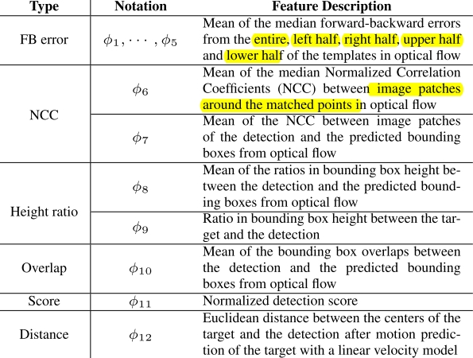
Lost State Policy – Features

Slide 11
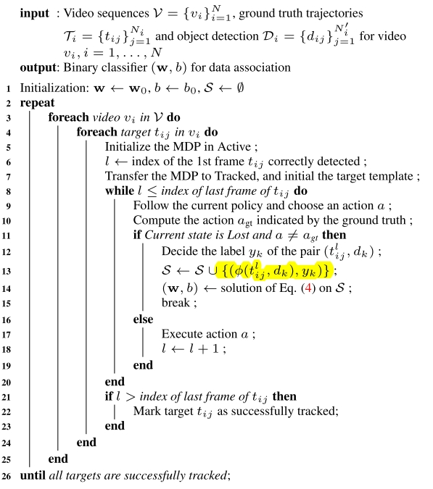
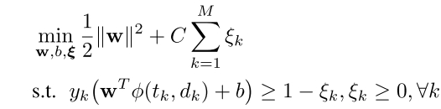
Lost State Policy – RL Algorithm
Update Classifier by solving soft margin optimization problem:

Slide 12
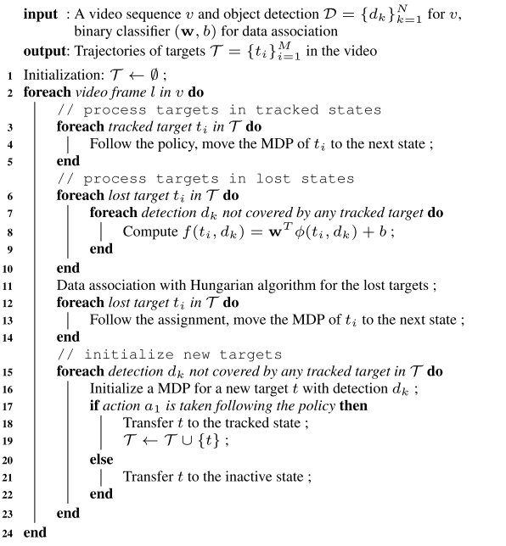
Overall MDP Tracking Algorithm

Slide 13
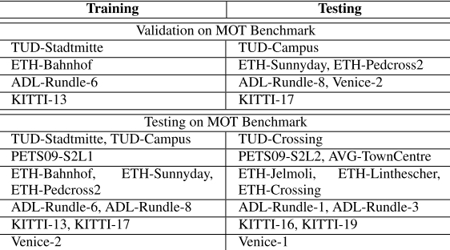
Datasets
Multi Object Tracking (MOT) benchmark
11 training and 11 testing sequences
Test sequence ground truth not available
6 of the training sequences used for validation
Training sequence captured in similar scenario
Notes:
For all test sequences except AVG town centre, there are training sequences captured in similar scenario as indicated by the naming of the sequences;
This can allow us to learn meaningful characteristics from training sequences and use them for testing;

Slide 14
Evaluation Metrics
Metric | Description
MOTA | Multiple Object Tracking Accuracy - combines three error sources: false positives, missed targets and identity switches
MOTP | Multiple Object Tracking Precision - misalignment between annotated and predicted bounding boxes
MT | Mostly tracked targets - percentage of ground truth trajectories that are covered by tracking output for at least 80% of their respective life span
ML | Mostly lost targets - Percentage of ground truth trajectories that are covered by tracking output less than 20% of their respective life span
FP | Total number of false positives
FN | Total number of false negatives (missed targets)
IDS | Total number of identity switches
Frag | Total number of times a trajectory is fragmented (i.e. interrupted during tracking)
Hz | Number of frames processed in one second
Higher is better
Lower is better

Slide 15
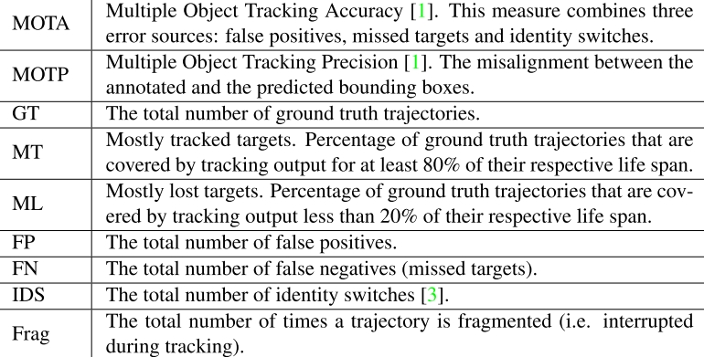
Evaluation Metrics

Slide 16
Analysis on Validation Set
Number of templates in the history (K)
K | MOTA | MOTP | MT | ML | FP | FN | IDS | Frag
1 | 24.7 | 73.2 | 10.3 | 55.1 | 3,597 | 13,651 | 147 | 303
2 | 25.7 | 73.5 | 9.8 | 53.4 | 3,548 | 13,485 | 121 | 349
3 | 23 | 73.6 | 8.5 | 56 | 3,727 | 13,907 | 134 | 325
4 | 26.3 | 73.9 | 9.8 | 53.8 | 3,191 | 13,726 | 91 | 300
5 | 26.7 | 73.7 | 12 | 53 | 3,386 | 13,415 | 111 | 331
6 | 19.5 | 73.7 | 5.6 | 68.8 | 3,393 | 14,920 | 269 | 321
7 | 26.1 | 73.6 | 10.7 | 55.6 | 3,092 | 13,838 | 132 | 306
8 | 25.8 | 73.8 | 10.7 | 55.6 | 3,221 | 13,785 | 122 | 305
9 | 26.7 | 73.6 | 12 | 51.7 | 3,290 | 13,491 | 133 | 328
10 | 26.6 | 73.8 | 9.8 | 55.1 | 2,691 | 14,130 | 123 | 276
11 | 25.3 | 73.5 | 12 | 52.1 | 3,672 | 13,436 | 136 | 317
12 | 24.8 | 73.4 | 11.5 | 55.6 | 3,637 | 13,585 | 139 | 321
Notes:
For all test sequences except AVG town centre, there are training sequences captured in similar scenario as indicated by the naming of the sequences;
This can allow us to learn meaningful characteristics from training sequences and use them for testing;

Slide 17
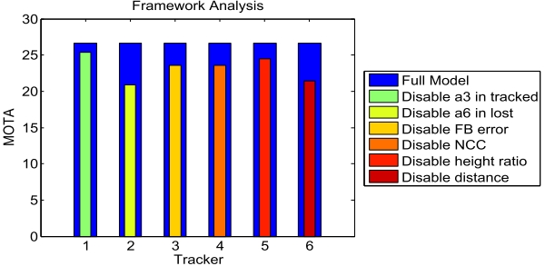
Analysis on Validation Set
Disabling different components
Notes:
For all test sequences except AVG town centre, there are training sequences captured in similar scenario as indicated by the naming of the sequences;
This can allow us to learn meaningful characteristics from training sequences and use them for testing;

Slide 18
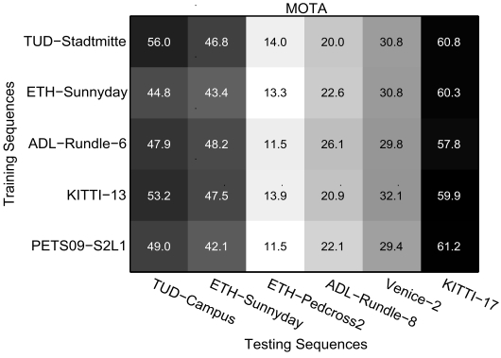
Analysis on Validation Set
Cross domain training and testing with MOTA
Notes:
For all test sequences except AVG town centre, there are training sequences captured in similar scenario as indicated by the naming of the sequences;
This can allow us to learn meaningful characteristics from training sequences and use them for testing;

Slide 19
Tested Trackers
DP NMS: H. Pirsiavash, D. Ramanan, and C. C. Fowlkes, ‘Globally-optimal greedy algorithms for tracking a variable number of objects’, CVPR 2011
TC ODAL: S.-H. Bae and K.-J. Yoon, ‘Robust online multi-object tracking based on tracklet conﬁdence and online discriminative appearance learning’, CVPR 2014
TBD: A. Geiger, M. Lauer, C. Wojek, C. Stiller, and R. Urtasun, ‘3d trafﬁc scene understanding from movable platforms’, TPAMI 2014
SMOT: C. Dicle, O. I. Camps, and M. Sznaier, ‘The way they move: Tracking multiple targets with similar appearance’, ICCV 2013
RMOT: J. H. Yoon, M.-H. Yang, J. Lim, and K.-J. Yoon, ‘Bayesian multi-object tracking using motion context from multiple objects’, WACV 2015
CEM: A. Milan, S. Roth, and K. Schindler, ‘Continuous energy minimization for multitarget tracking’, TPAMI 2014
SegTrack: A. Milan, L. Leal-Taix´e, K. Schindler, and I. Reid, ‘Joint tracking and segmentation of multiple targets’, CVPR 2015
MotiCon: L. Leal-Taix´e, M. Fenzi, A. Kuznetsova, B. Rosenhahn, and S. Savarese, ‘Learning an image-based motion context for multiple people tracking’, CVPR 2014
Notes:
For all test sequences except AVG town centre, there are training sequences captured in similar scenario as indicated by the naming of the sequences;
This can allow us to learn meaningful characteristics from training sequences and use them for testing;

Slide 20
Results
MDP REL: MDP Reinforcement Learning
MDP OFL: MDP Ofﬂine Learning
Link detections using ground truth to form target trajectories
Pairs of target and detection that should/should not be linked between adjacent frames
Tracker | Tracking Mode | Learning Mode | MOTA | MOTP | MT | ML
DP NMS | Batch | N/A | 14.5 | 70.8 | 6.00% | 40.80%
TC ODAL | Online | Online | 15.1 | 70.5 | 3.20% | 55.80%
TBD | Batch | Ofﬂine | 15.9 | 70.9 | 6.40% | 47.90%
SMOT | Batch | N/A | 18.2 | 71.2 | 2.80% | 54.80%
RMOT | Online | N/A | 18.6 | 69.6 | 5.30% | 53.30%
CEM | Batch | N/A | 19.3 | 70.7 | 8.50% | 46.50%
SegTrack | Batch | Ofﬂine | 22.5 | 71.7 | 5.80% | 63.90%
MotiCon | Batch | Ofﬂine | 23.1 | 70.9 | 4.70% | 52.00%
MDP OFL | Online | Ofﬂine | 30.1 | 71.6 | 10.40% | 41.30%
MDP REL | Online | Online | 30.3 | 71.3 | 13.00% | 38.40%
Notes:
For all test sequences except AVG town centre, there are training sequences captured in similar scenario as indicated by the naming of the sequences;
This can allow us to learn meaningful characteristics from training sequences and use them for testing;

Slide 21
Results
MDP REL: MDP Reinforcement Learning
MDP OFL: MDP Ofﬂine Learning
Link detections using ground truth to form target trajectories
Pairs of target and detection that should/should not be linked between adjacent frames
Tracker | Tracking Mode | FP | FN | IDS | Frag | Hz
DP NMS | Batch | 13,171 | 34,814 | 4,537 | 3,090 | 444.8
TC ODAL | Online | 12,970 | 38,538 | 637 | 1,716 | 1.7
TBD | Batch | 14,943 | 34,777 | 1,939 | 1,963 | 0.7
SMOT | Batch | 8,780 | 40,310 | 1,148 | 2,132 | 2.7
RMOT | Online | 12,473 | 36,835 | 684 | 1,282 | 7.9
CEM | Batch | 14,180 | 34,591 | 813 | 1,023 | 1.1
SegTrack | Batch | 7,890 | 39,020 | 697 | 737 | 0.2
MotiCon | Batch | 10,404 | 35,844 | 1,018 | 1,061 | 1.4
MDP OFL | Online | 8,789 | 33,479 | 690 | 1,301 | 0.8
MDP REL | Online | 9,717 | 32,422 | 680 | 1,500 | 1.1
Notes:
For all test sequences except AVG town centre, there are training sequences captured in similar scenario as indicated by the naming of the sequences;
This can allow us to learn meaningful characteristics from training sequences and use them for testing;

Slide 22
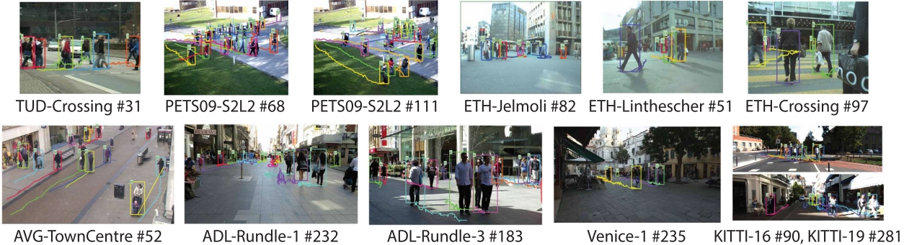
Results
Notes:
For all test sequences except AVG town centre, there are training sequences captured in similar scenario as indicated by the naming of the sequences;
This can allow us to learn meaningful characteristics from training sequences and use them for testing;

Slide 23
Thanks !
Notes:
For all test sequences except AVG town centre, there are training sequences captured in similar scenario as indicated by the naming of the sequences;
This can allow us to learn meaningful characteristics from training sequences and use them for testing;

